Slide 1
State Machine
An Interactive pedagogical tool
-Nikhil Verma

Slide 2
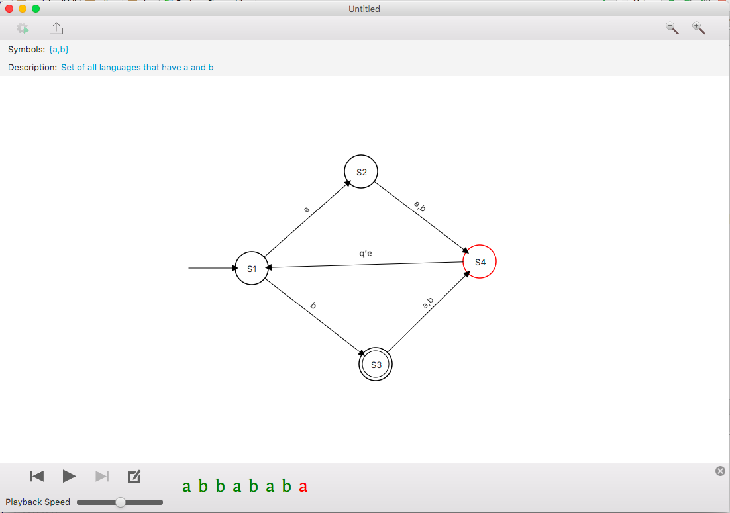
DFA Designer and Tester

Slide 3
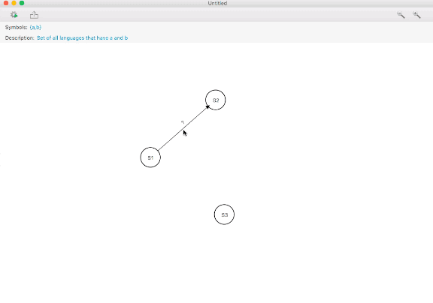
AOP in a GUI application?
Undo Redo
Preventing Mouse Events
Observer notification
Logging
Performance Tracking

Slide 4
Implementation
Model View Controller and more

Slide 5
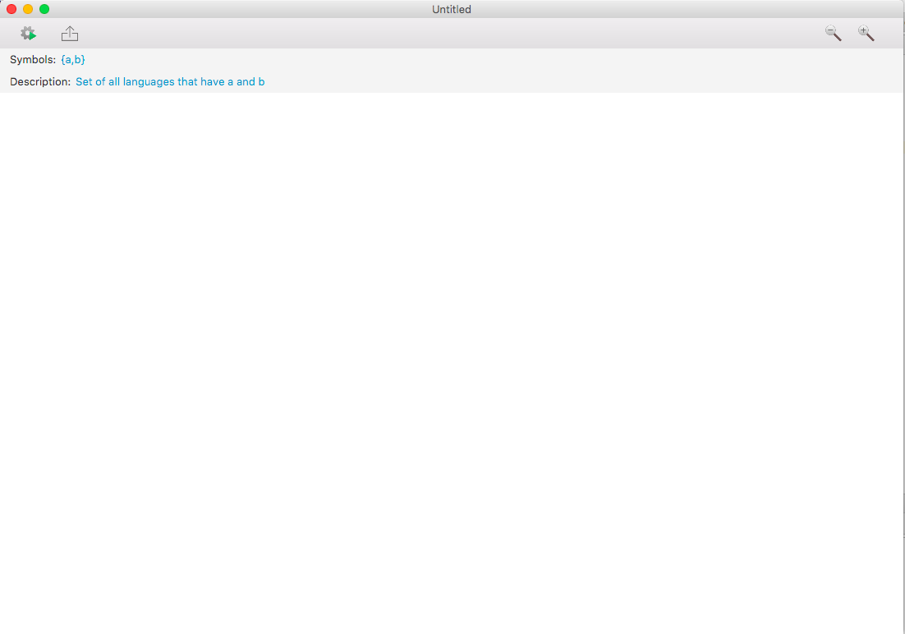
Event Handling is important
Do something when this button is pressed
Handle the following mouse events on this View:
Mouse pressed
Mouse dragged
Mouse released
Mouse clicked

Slide 6
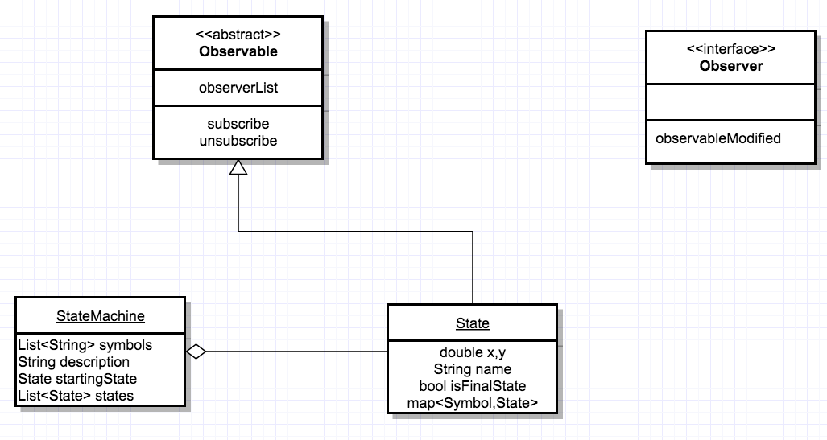
Model

Slide 7
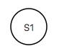
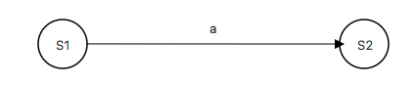
Views
StateView
TransitionView

Slide 8
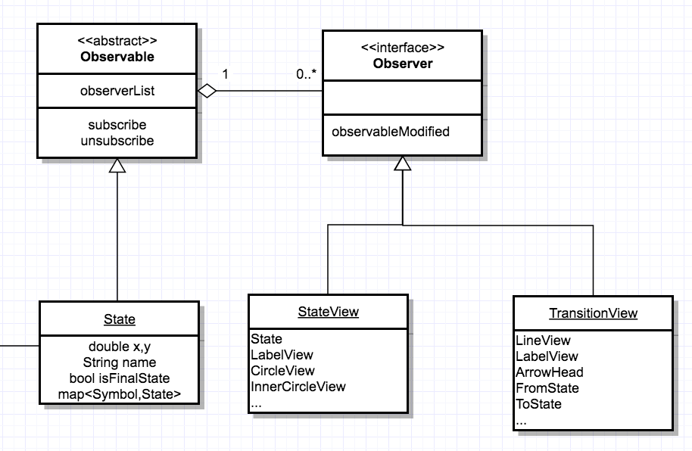

Slide 9
JavaFX’s FXML file
Much like HTML, this file declaratively makes the user interface
Events are configured to a target
Events are basically methods that get called when something happens(such as a mouse click)

Slide 10
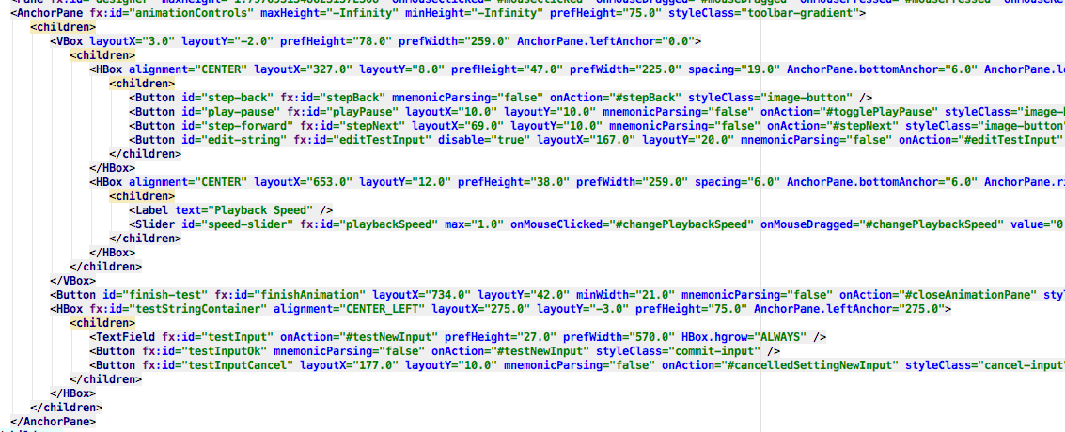
JavaFX’s FXML file

Slide 11
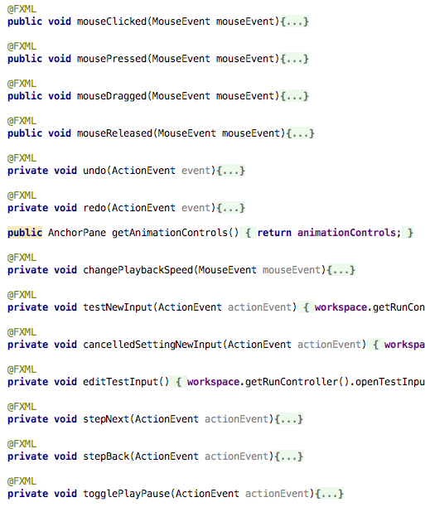
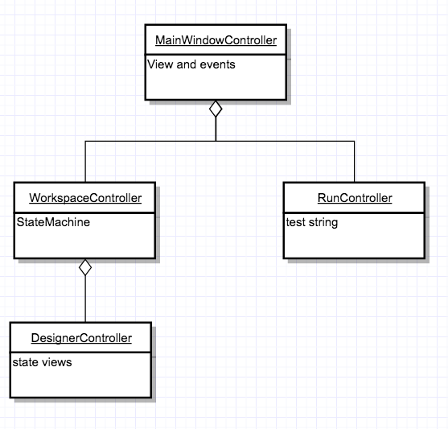
Controller

Slide 12
UNDO REDO
COMMAND PATTERN

Slide 13
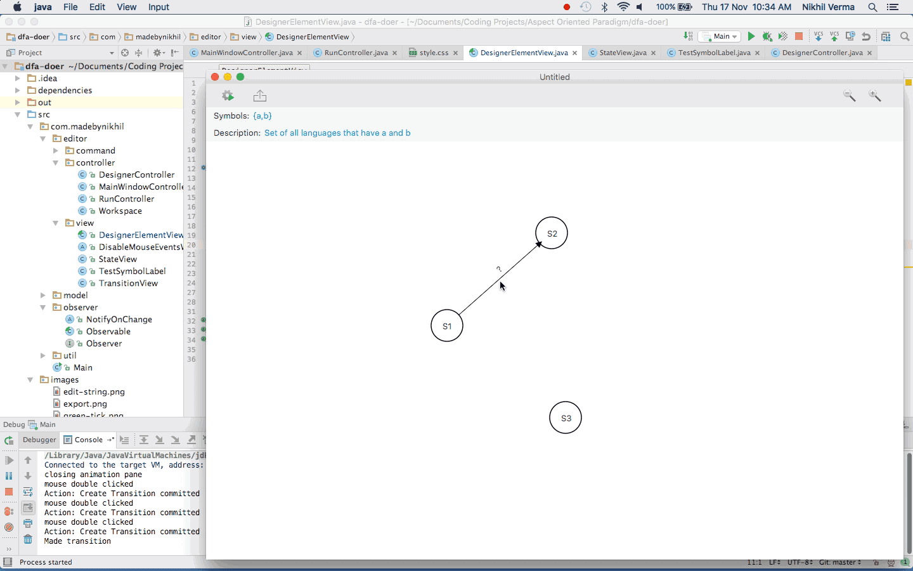
EVERY ACTION IS UNDOABLE AND REDOABLE

Slide 14
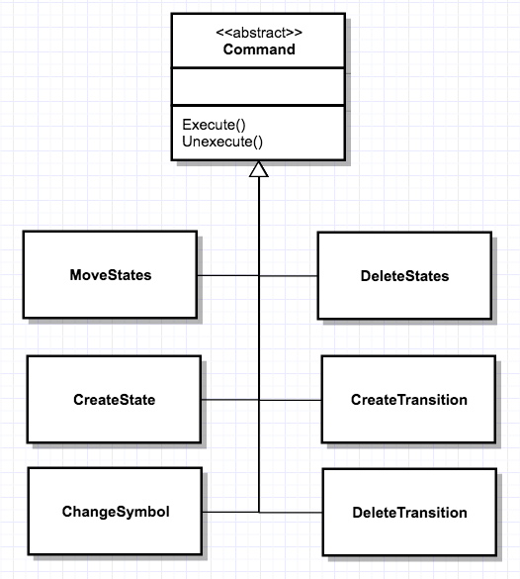
Every operation is a command
Executed on several events
Cross cutting concern
Self contained in their operation
Stored as objects in memory

Slide 15
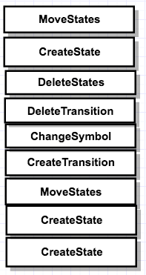
History Stack
Future Stack

Slide 16
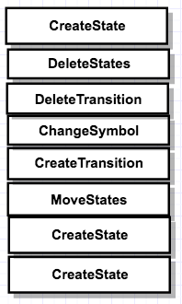
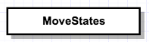
On Undo Event
Unexecute()
History Stack
Future Stack

Slide 17
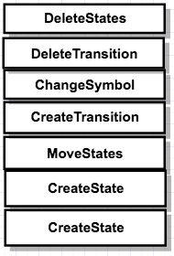
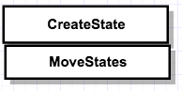
On Undo Event
Unexecute()
History Stack
Future Stack

Slide 18
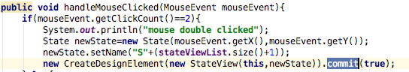
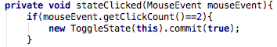
UndoRedo Aspect
Pointcut while committing a command

Slide 19
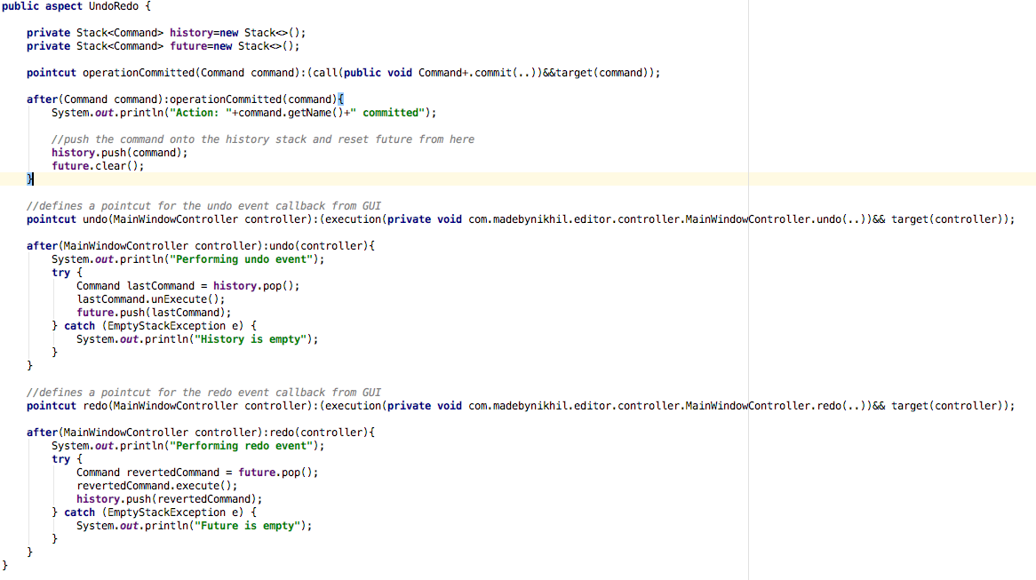

Slide 20
Disabling mouse events on several subviews
Using an around advice

Slide 21
States and Transitions cant be clicked during string testing
Mouse events should be disabled on these subviews

Slide 22
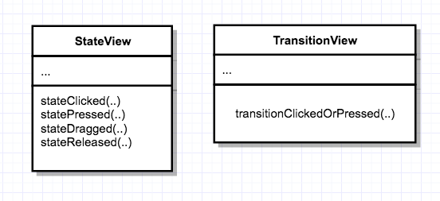
Events happen in several subviews

Slide 23
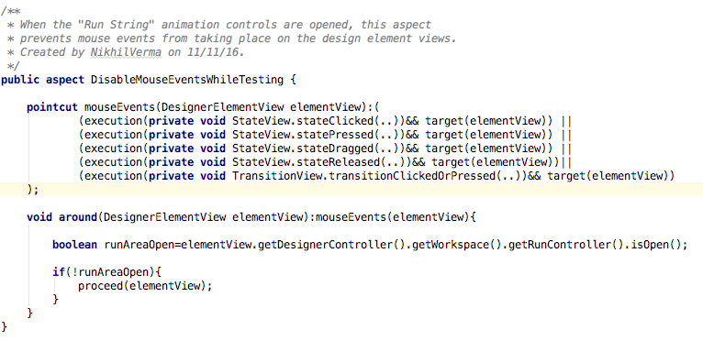
Disabled using an around advice

Slide 24
Moving states and its reaction
Observer pattern

Slide 25
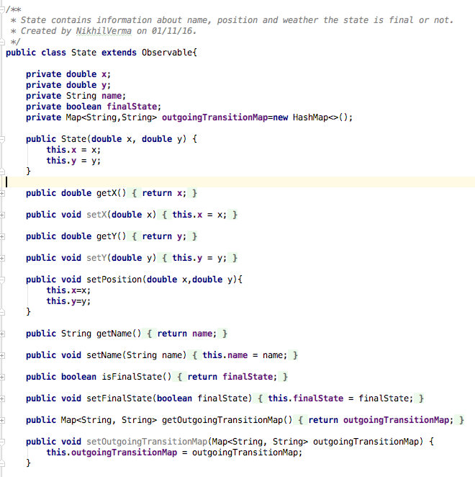
“State” model is observable
Who is observing?
StateView
TransitionView

Slide 26
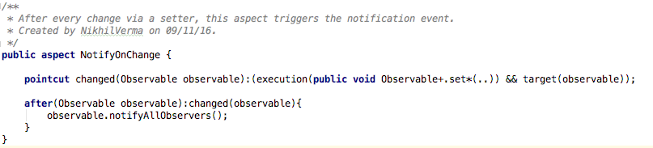
Observers notified by aspect

Slide 27
Performance Tracking
Annotation based using aspects

Slide 28
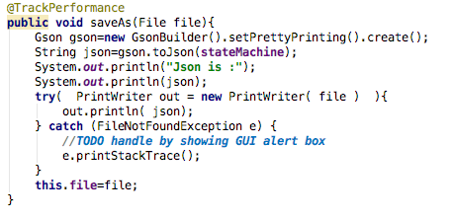
While saving the file as JSON

Slide 29
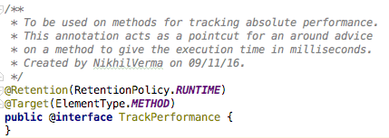
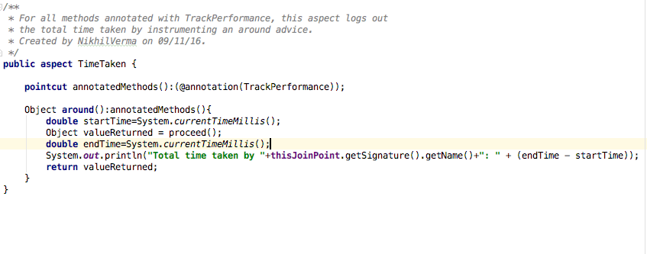

Slide 30
Timeshift
One of my other GUI projects without AOP
(for context)

Slide 31
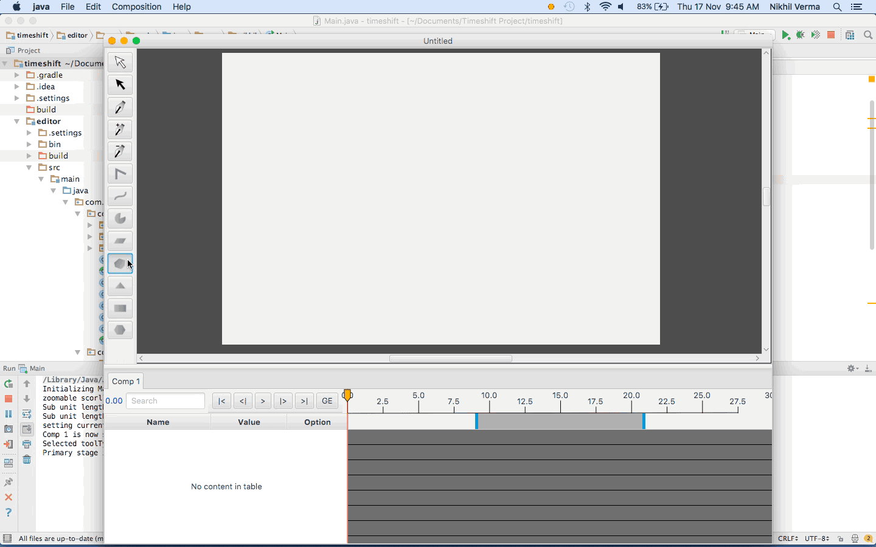

Slide 32
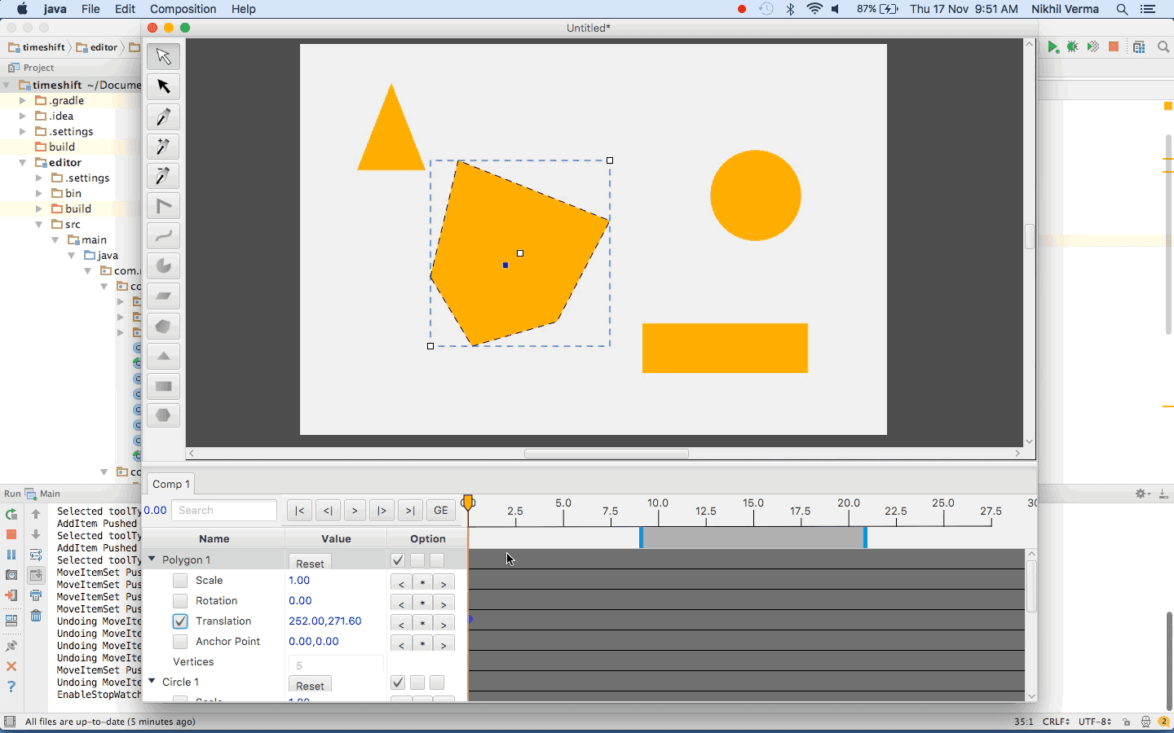

Slide 33
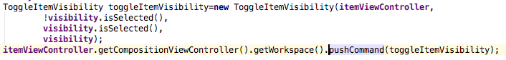
History stack is in a “Workspace” class

Slide 34
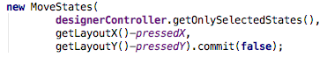
Aspects make handling command operations easier

Slide 35
Q/A
Madebynikhil.com

